Slide 1

A Comprehensive Guide to Data Science
Fundamental Concepts and Industry Significance
Williams Boluwatife
15th December 2024.

Slide 2

What is Data Science?
Data science is an emerging discipline that focuses on analyzing data, extracting useful knowledge, and building predictive models. It uses statistical methodology and computer science to create impactful predictions and insights for various scholarly fields(Baviskar et al 2021).
Techniques For Data Science
Different techniques are available for data science depending on the type of data and amount of data collected.
Techniques based on Mathematics and Statistics
Techniques based on Artificial Intelligence and Machine Learning
Techniques based on Visualisation and Graphs

Slide 3
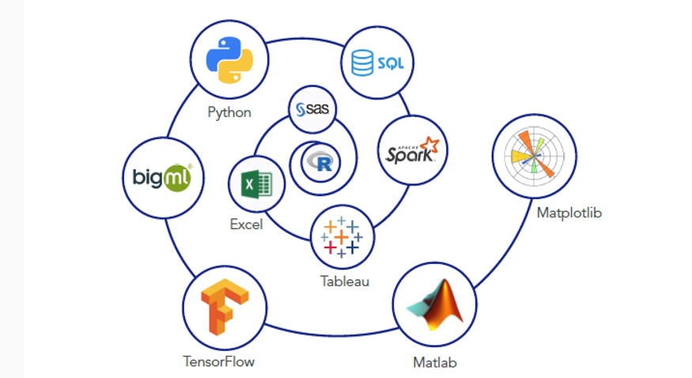
Tools Used In Data Science
Making judgements is the primary responsibility of data scientists, they accomplish this by evaluating and managing large amounts of both organised and unstructured data. Data scientists must therefore use computer languages and tools to handle such a vast amount of data in order to analyse it and carry out their duties effectively. These tools can be open source or close sourced, a few of them are; SAS, Apache spark, BigML, D3.js, Matlab, Excel, Tableau, ggplot 2, Jupyter, Matplotlib, Scikit-Learn, TensorFlow, Weka(Bansal et al 2018).

Slide 4
Why is Data Science Important?
• It addresses growing business needs through effective data use.
• Data Science corrects previous project drawbacks or data mishandling.
• Finds interesting patterns within data using statistical techniques like data extraction, wrangling, and pre-processing.
• Data Science helps in making meaningful conclusions from data for smarter business decisions.
• Innovations in areas like applied computing, medical sciences, professionals & social life activities, computing paradigms, and data management systems.

Slide 5
Fundamental Concept
Following a structured approach helps maximize chances of success in a data science project at the lowest cost(Brodie & Micheal 2019).
The first phase is data collection, you want to have data available for analysis.
Now that raw data is available, it’s time to prepare it. This includes transforming the data from a raw form into data that’s directly usable in your models. To achieve this, you’ll detect and correct different kinds of errors in the data, combine data from different data sources, and transform.
The next step is data exploration. The goal of this step is to gain a deep understanding of the data.
Model building comes next, It is at this stage inisghts are gained and predictions are made.
The penultimate step of the data science model is presenting results and automating analysis.
The final step is deployment of results of the project and integrating into the organization.

Slide 6
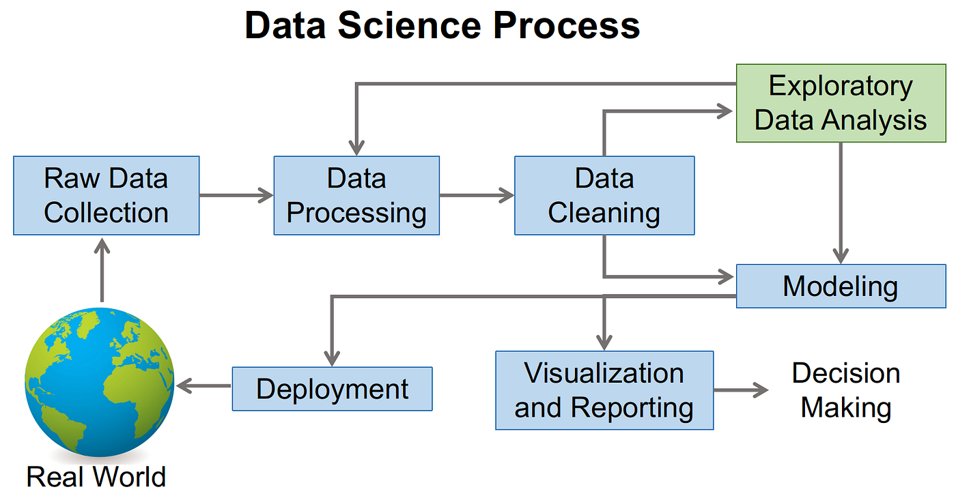

Slide 7
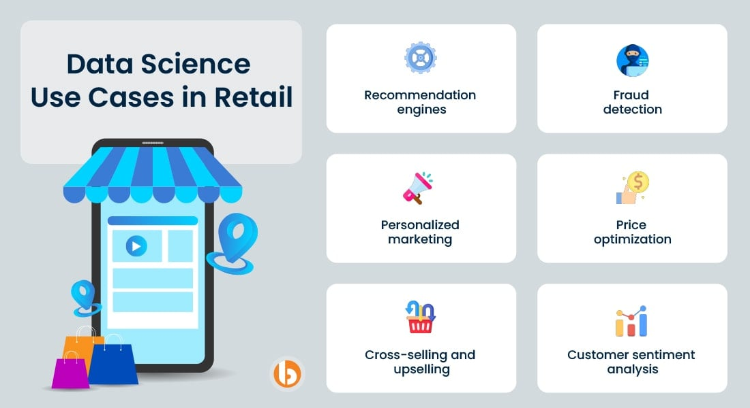
Application of Data Science Across Industries
Source: https://www.bacancytechnology.com/blog/wp-content/uploads/2022/05/Data-Science-Use-Cases-in-Retail-min.jpg

Slide 8
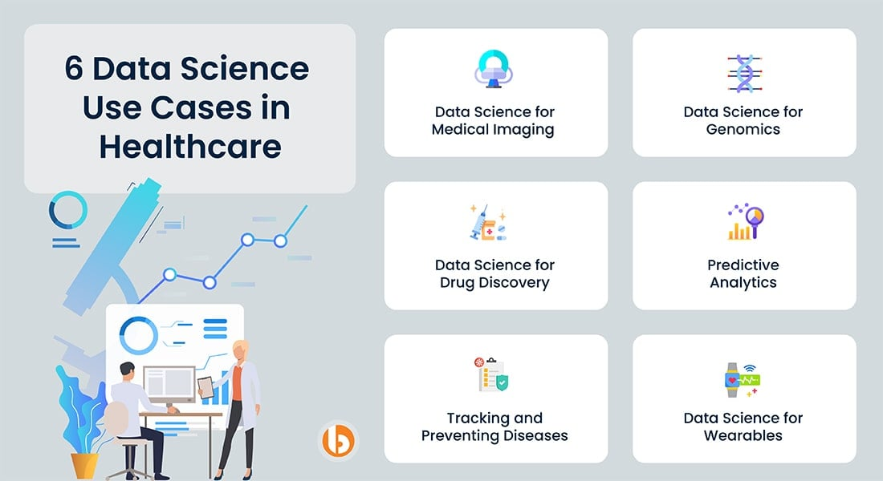
Application of Data Science Across Industries
Source: https://th.bing.com/th/id/OIP.pFTnEnugjSCoIuK69EPJcAHaEC?pid=ImgDet&w=188&h=102&c=7

Slide 9
Conclusion Data science has the potential to revolutionize various industries, driving innovation, efficiency, and progress. As technology continues to advance, we can expect to see even more transformative applications of data science in the years to come.
References
Bansal, A., & Srivastava, S. (2018). Tools used in data analysis: A comparative study. International Journal of Recent Research, 5(1), 15-18.
Baviskar, M. R., Nagargoje, P. N., Deshmukh, P. A., & Baviskar, R. R. (2021). A survey of data science techniques and available tools. International Research Journal of Engineering and Technology (IRJET), 8(04), 4258-4263
Brodie, M. L. (2019). What is data science?. Applied data science: Lessons learned for the data-driven business, 101-130.

